Slide 1
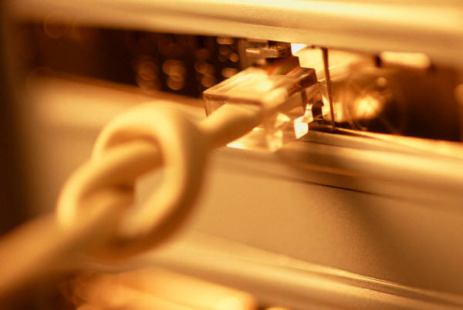
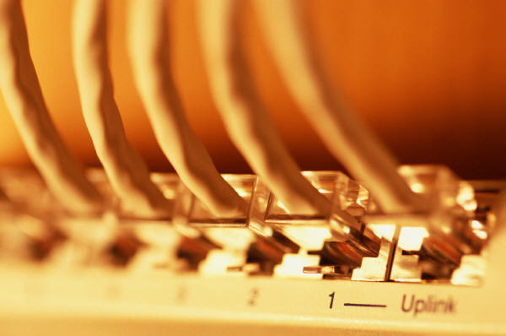
Computer Networking
Notes:
I tried to keep the colors oranges, tans, and black for consistency throughout my presentation. I also felt a border throughout my project would make it stand out more. I kept the font at Arial throughout the presentation. The only change that I used was to bold it and highlight with colors here and there.

Slide 2
Course Content
Networks: Basic concepts
Uses of networks in sharing of resources, Backups
Common types of networks; LAN/WAN/Internet, Server based networks, client server model, P2P
Network media
Wireless networks.
Threats to networks
The internet world
Cloud and Cloud Computing
Notes:
I especially liked this graphic. I felt it would be good for an introduction. While it wasn’t really in the color scheme, it was modern and caught people’s eye.

Slide 3
The Computer Network
A computer network is a group of computers/devices(Nodes) that use a set of common communication protocols over digital interconnections for the purpose of sharing resources located on or provided by the network nodes.
The nodes of a computer network may include personal computers, servers, networking hardware, or other specialised or general-purpose hosts.
The interconnections between nodes are formed from a broad spectrum of telecommunication network technologies, based on physically wired, optical, and wireless technologies.
A communication protocol is a set of rules for exchanging information over a network. physically wired, optical, and wireless

Slide 4
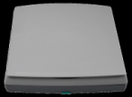


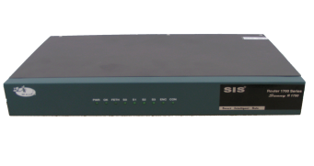
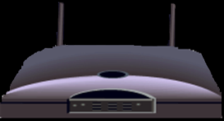
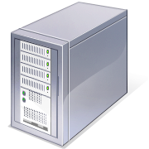
The Network Diagram (Click on the Words Below and Learn More About Each Component)
Wired Network
PC
Firewall
The Internet
Fiber Optic Network Cable
Router
Switch
Server
Other LANS
Wireless Network
Notes:
I wanted to present this diagram to help the viewer visually understand how a computer network was set-up. I linked each component to the same text links throughout the project.

Slide 5
The Advantages/Uses of Network
Simultaneous Access
There are moments in any business when several workers may need to use the same data at the same time.
Shared Peripheral Devices
Personal Communications
Videoconferencing
Voice over Internet Protocol (VoIP):-VoIP transmits the sound of voice over a computer network using the Internet Protocol (IP ) rather than sending the signal over traditional phone wires
Easier Data Backup

Slide 6
The Networking Devices(Nodes)
NIC Card
Repeater
Hub
Switch
Bridge
Router
Gateway
Firewall

Slide 7
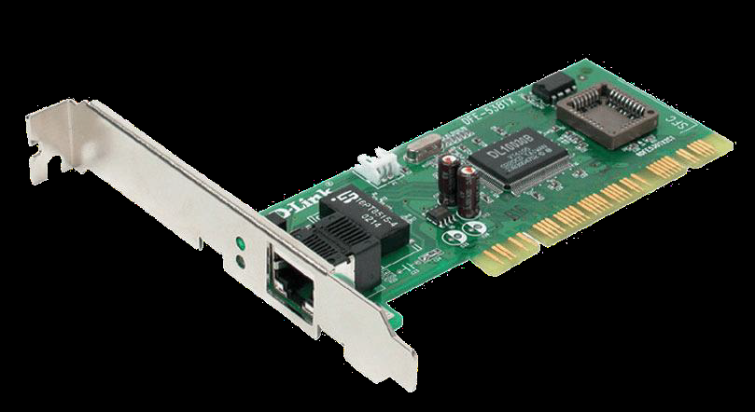
1. Network Interface Card
NIC is used to physically connect host devices to the network media.
A NIC is a printed circuit board that fits into the expansion slot of a bus on a computer motherboard.
It can also be a peripheral device. NICs are sometimes called network adapters.
Each NIC is identified by a unique code called a Media Access Control (MAC) address.
This address is used to control data communication for the host on the network.
Notes:
Once again, I tried to pull graphics from the original network diagram. I had to alter the wireless router graphic in Photoshop to make it look better. I darken the and removed a white background to make it look consistent in relation to the standard router.

Slide 8
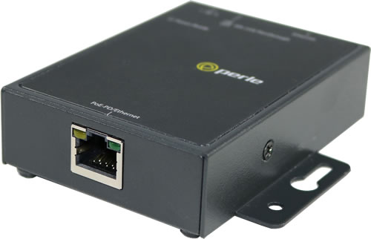
2. Repeaters
A repeater is a network device used to regenerate a signal.
Repeaters regenerate analog or digital signals that are distorted by transmission loss due to attenuation.
A repeater does not make an intelligent decision concerning forwarding packets
Notes:
Once again, I tried to pull graphics from the original network diagram. I had to alter the wireless router graphic in Photoshop to make it look better. I darken the and removed a white background to make it look consistent in relation to the standard router.

Slide 9
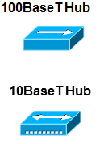
3. Hubs
Hubs concentrate on connections.
In other words, they take a group of hosts and allow the network to see them as a single unit. This is done passively, without any other effect on the data transmission.
Active hubs concentrate hosts and also regenerate signals.
Notes:
Once again, I tried to pull graphics from the original network diagram. I had to alter the wireless router graphic in Photoshop to make it look better. I darken the and removed a white background to make it look consistent in relation to the standard router.

Slide 10
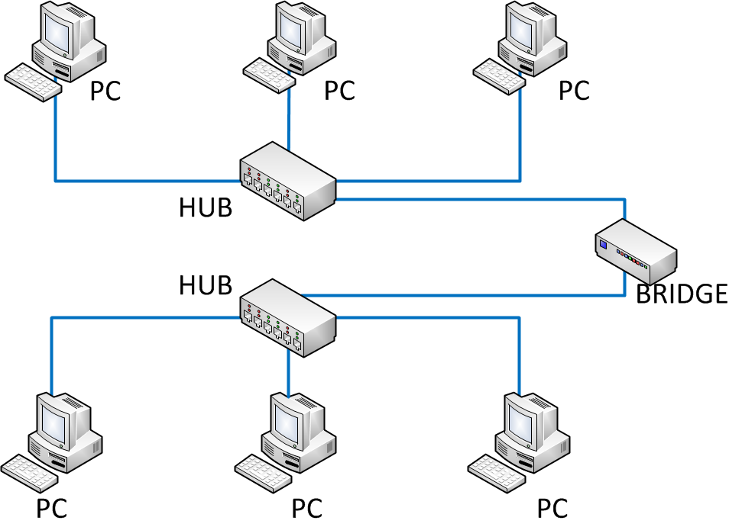
4. Bridges
Bridges convert network data formats and perform basic data transmission management.
Bridges provide connections between LANs.
They also check data to determine if it should cross the bridge. This makes each part of the network more efficient
Notes:
Once again, I tried to pull graphics from the original network diagram. I had to alter the wireless router graphic in Photoshop to make it look better. I darken the and removed a white background to make it look consistent in relation to the standard router.

Slide 11
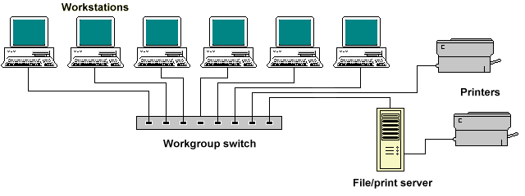
5. Switches
Switches add more intelligence to data transfer management.
They can determine if data should remain on a LAN and transfer data only to the connection that needs it.
Another difference between a bridge and switch is that a switch does not convert data transmission formats
Notes:
Once again, I tried to pull graphics from the original network diagram. I had to alter the wireless router graphic in Photoshop to make it look better. I darken the and removed a white background to make it look consistent in relation to the standard router.

Slide 12
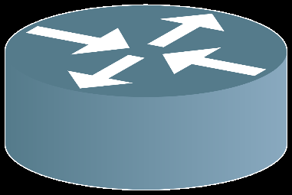
6. Routers
Routers have all the capabilities listed above.
Routers can regenerate signals, concentrate multiple connections, convert data transmission formats, and manage data transfers.
They can also connect to a WAN, which allows them to connect LANs that are separated by great distances.
Notes:
Once again, I tried to pull graphics from the original network diagram. I had to alter the wireless router graphic in Photoshop to make it look better. I darken the and removed a white background to make it look consistent in relation to the standard router.

Slide 13
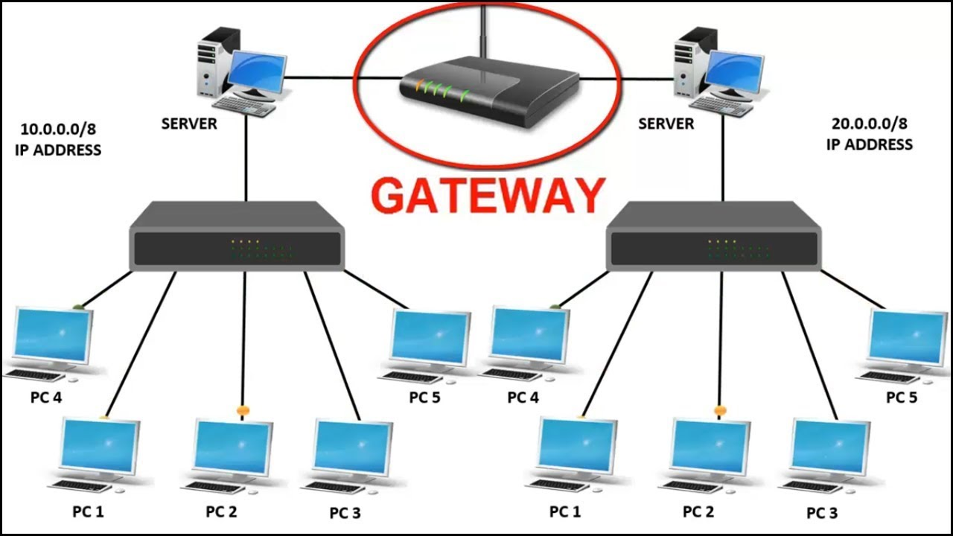
7. Gateway
A gateway is a piece of networking hardware used in telecommunications for telecommunications networks that allows data to flow from one discrete network to another.
Gateways are distinct from routers or switches in that they communicate using more than one protocol to connect a bunch of networks
Notes:
Once again, I tried to pull graphics from the original network diagram. I had to alter the wireless router graphic in Photoshop to make it look better. I darken the and removed a white background to make it look consistent in relation to the standard router.

Slide 14
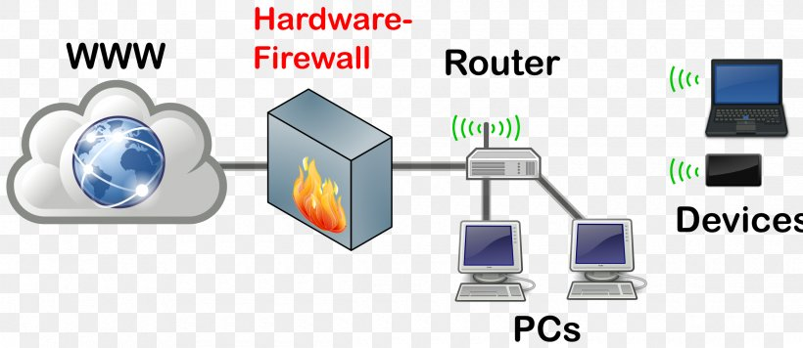
8. Firewall
A firewall is a network device or software for controlling network security and access rules.
Firewalls are inserted in connections between secure internal networks and potentially insecure external networks such as the Internet.
Firewalls are typically configured to reject access requests from unrecognized sources while allowing actions from recognized ones.
The vital role firewalls play in network security grows in parallel with the constant increase in cyber attacks.
Notes:
Once again, I tried to pull graphics from the original network diagram. I had to alter the wireless router graphic in Photoshop to make it look better. I darken the and removed a white background to make it look consistent in relation to the standard router.

Slide 15
Network Media
The function of the media is to carry a flow of information through a LAN.
Wired Media:- A widely adopted family that uses copper and fiber media in local area network (LAN) technology are collectively known as Ethernet
Copper Cable
Coaxial Cables
Shielded Twisted Pair(STP)
Unshielded Twisted Pair
Fibre Optic Cable
Wireless Media:- use the atmosphere, or space, as the medium.
Notes:
Once again, I tried to pull graphics from the original network diagram. I had to alter the wireless router graphic in Photoshop to make it look better. I darken the and removed a white background to make it look consistent in relation to the standard router.

Slide 16
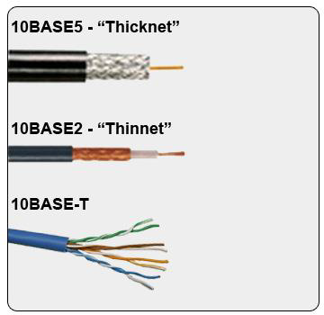
1. Copper Cable
The most common, easiest, quickest, and cheapest form of network media to install.
The disadvantage of sending data over copper wire is that the further the signal travels, the weaker it becomes.
Notes:
Once again, I tried to pull graphics from the original network diagram. I had to alter the wireless router graphic in Photoshop to make it look better. I darken the and removed a white background to make it look consistent in relation to the standard router.

Slide 17
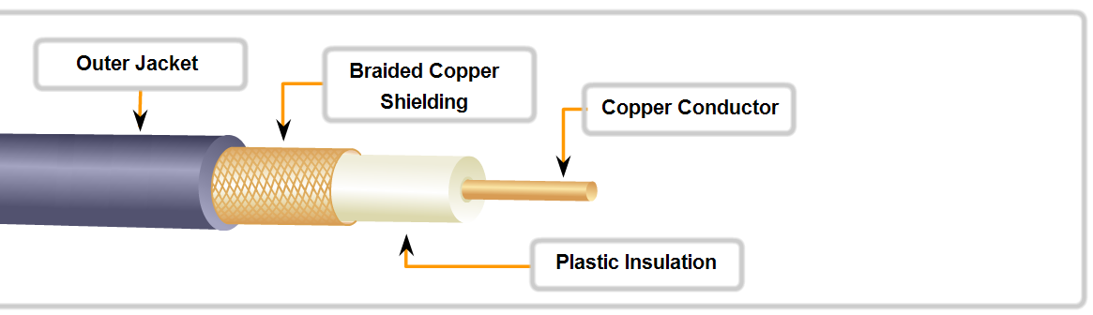
a. Coaxial Cable
It can be run longer distances than Twisted pair Cables.
Speed: 10-100Mbps
• Cost: Inexpensive
• Media and connector size: Medium
• Maximum cable length: 500m
Notes:
Once again, I tried to pull graphics from the original network diagram. I had to alter the wireless router graphic in Photoshop to make it look better. I darken the and removed a white background to make it look consistent in relation to the standard router.

Slide 18
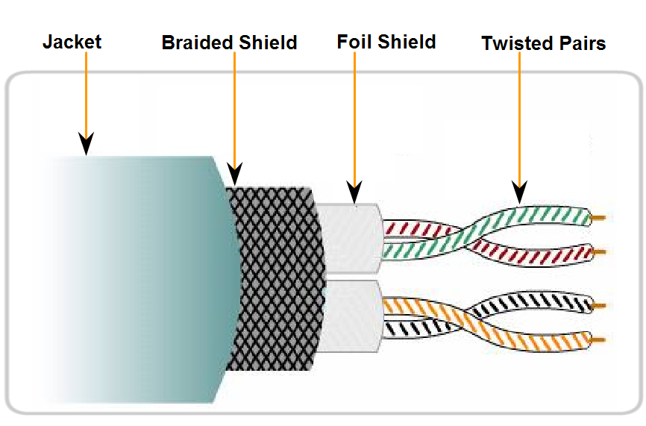
b. Shielded Twisted Pair(STP)
Speed: 0-100Mbps
Cost: Moderate
Media and connector size: Medium to large
Maximum cable length: 100m
Notes:
Once again, I tried to pull graphics from the original network diagram. I had to alter the wireless router graphic in Photoshop to make it look better. I darken the and removed a white background to make it look consistent in relation to the standard router.

Slide 19
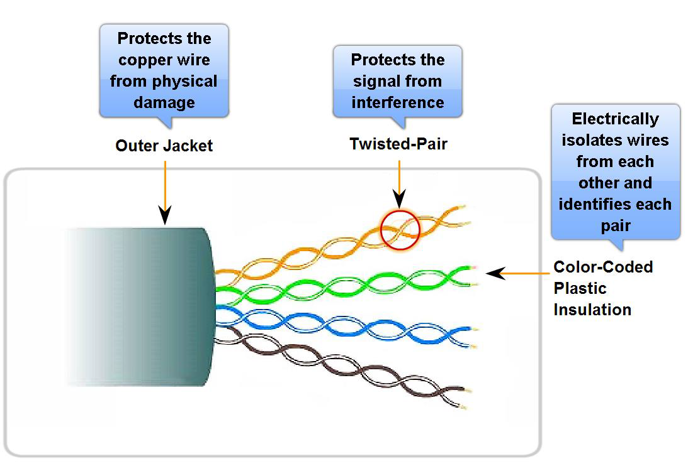
c. Unshielded Twisted Pair
UTP is a four-pair wire medium used in a variety of networks.
Each of the eight copper wires in the UTP cable is covered by insulating material
Speed: 10-100-1000 Mbps*
Cost: Least Expensive
Media and connector size: Small
Maximum cable length: 100m * (Depending on the quality/category of cable)
Notes:
Once again, I tried to pull graphics from the original network diagram. I had to alter the wireless router graphic in Photoshop to make it look better. I darken the and removed a white background to make it look consistent in relation to the standard router.

Slide 20
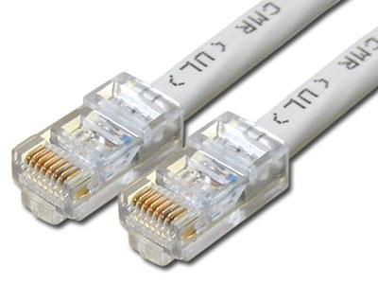
UTP Implementation
EIA/TIA specifies an RJ-45 connector for UTP cable.
The letters RJ stand for registered jack.

Slide 21
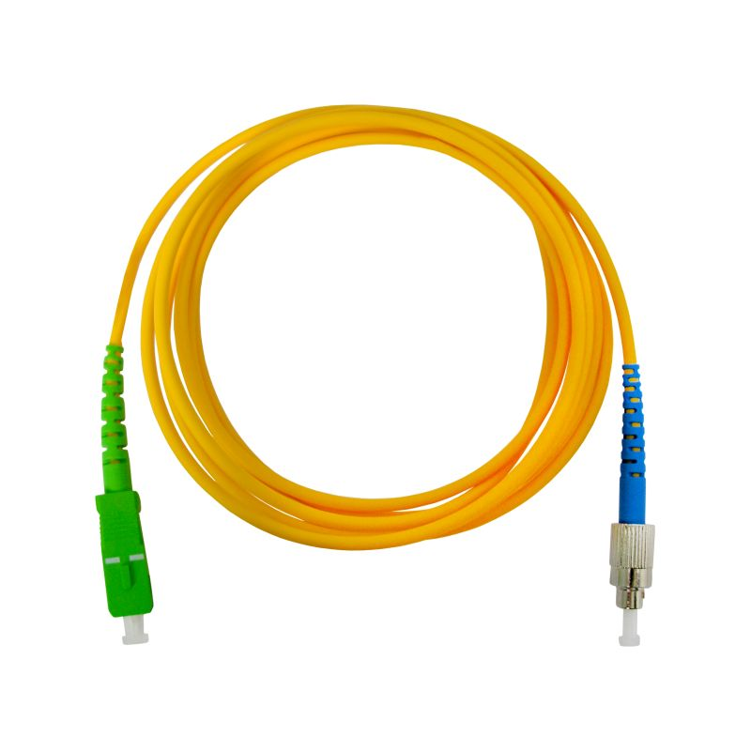
Fiber Optic Cable
Glass fiber carrying light pulses, each pulse a bit.
Based on the Total Internal Reflection of Light.
High-speed point-to-point transmission 10-100’s Gbps
low error rate:
repeaters spaced far apart
immune to electromagnetic noise

Slide 22
Communication Protocols
Internet Protocol Suite
Also called TCP/IP, is the foundation of all modern networking.
It defines the addressing, identification, and routing specifications for IPv4 and for IPv6.
It is the defining set of protocols for the Internet.
IEEE 802
It is a family of IEEE standards dealing with local area networks and metropolitan area networks.
They operate mostly at levels 1 and 2 of the OSI model.
Ethernet
It is a family of protocols used in wired LANs, described by a set of standards together called IEEE 802.3
Notes:
Once again, I tried to pull graphics from the original network diagram. I had to alter the wireless router graphic in Photoshop to make it look better. I darken the and removed a white background to make it look consistent in relation to the standard router.

Slide 23
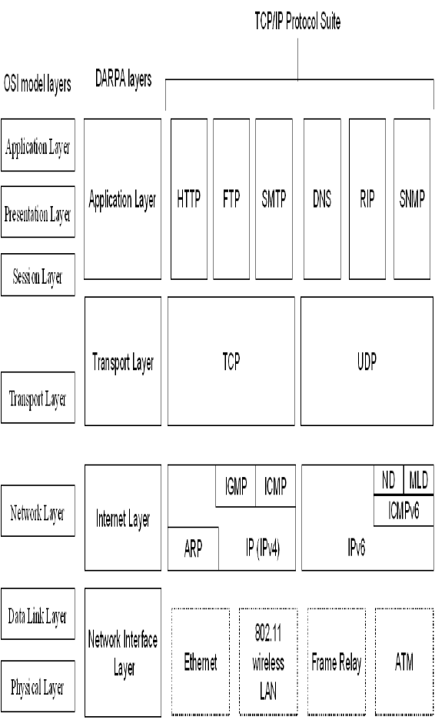
TCP/IP Protocol Suite

Slide 24
Communication Protocols
Wireless LAN
It is standardized by IEEE 802.11 and shares many properties with wired Ethernet.
SONET/SDH
Synchronous optical networking (SONET) and Synchronous Digital Hierarchy (SDH) are standardized multiplexing protocols that transfer multiple digital bit streams over optical Fibre using lasers.
Asynchronous Transfer Mode(ATM)
It uses asynchronous time-division multiplexing and encodes data into small, fixed-sized cells.
Good choice for a network that handle both traditional high-throughput data traffic, and real-time, low-latency content such as voice and video.
Notes:
Once again, I tried to pull graphics from the original network diagram. I had to alter the wireless router graphic in Photoshop to make it look better. I darken the and removed a white background to make it look consistent in relation to the standard router.

Slide 25
Types of Networks
Personal Area Network (PAN)
Local Area Network (LAN)
Campus Area Network (CAN)
Metropolitan Area Network (MAN)
Wide Area Network (WAN)
Storage-Area Network (SAN)
Virtual Private Network (VPN)
Client Server Network
Peer to Peer Network (P2P)
Notes:
I used this slide as a Introduction to the different types of networks. I tried to let the graphics do the talking on this slide. I elaborated more on each network type on subsequent slides.

Slide 26
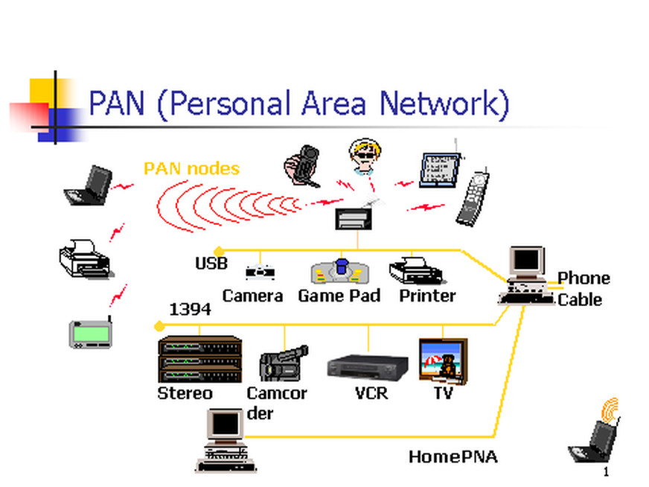
1. Personal Area Network
Personal Area Network (PAN) is a computer network used for data transmission amongst devices such as computers, telephones, tablets and personal digital assistants.
Also Known as HAN (Home Area Network)
PANs can be used for communication amongst the personal devices themselves (interpersonal communication), or for connecting to a higher level network and the Internet (an uplink) where one "master" device takes up the role as internet router.
Notes:
I kept the graphic the same as the previous graphic representing the Wide Area Network in hopes of creating a degree familiarity. I also include some basic facts about it.

Slide 27
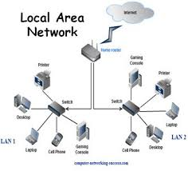
2. Local Area Network
Xerox Corporation worked in collaboration with DEC and Intel to create Ethernet, which is the most pervasive LAN architecture used today.
Ethernet has evolved and has seen significant improvements in regard to speed and efficiency.
An upside of a LAN is fast data transfer with data speed that can reach up to 10Gbps.
Other significant LAN technologies are Fiber Distributed Data Interface (FDDI) and token ring.
Notes:
I kept the graphic the same as the previous graphic representing the Local Area Network in hopes of creating a degree familiarity. I also include some basic facts about it.

Slide 28
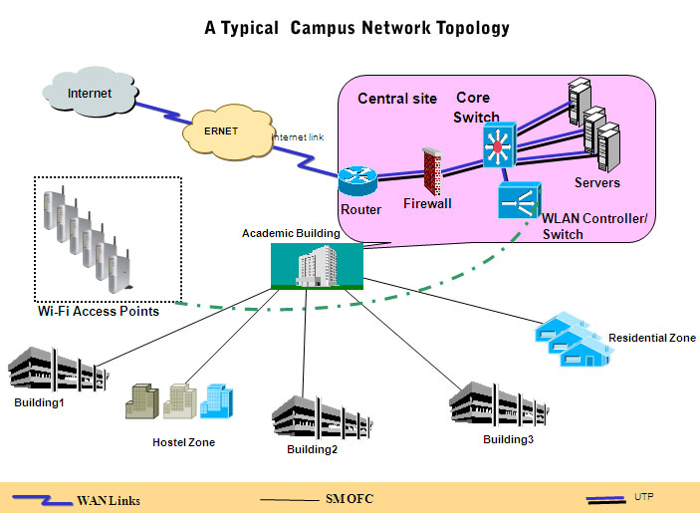
3. Campus Area Network
Larger than LANs, but smaller than metropolitan area networks these types of networks are typically seen in universities, large K-12 school districts or small businesses.
They can be spread across several buildings that are fairly close to each other so users can share resources
Notes:
I kept the graphic the same as the previous graphic representing the Local Area Network in hopes of creating a degree familiarity. I also include some basic facts about it.

Slide 29
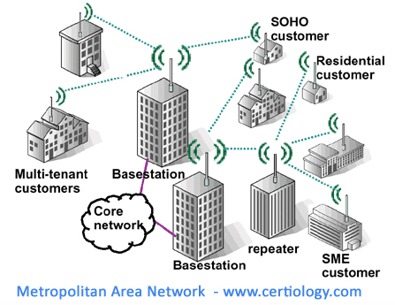
4. Metropolitan Area Network
A MAN is larger than a LAN but smaller than or equal in size to a WAN.
The size range anywhere from 5 to 50km in diameter.
MANs are typically owned and managed by a single entity.
This could be an ISP or telecommunications company that sells its services to end-users in that metropolitan area.
For all intents and purposes, a MAN has the same characteristics as a WAN with distance constraints.
Notes:
I kept the graphic the same as the previous graphic representing the Wide Area Network in hopes of creating a degree familiarity. I also include some basic facts about it.

Slide 30

5. Wide Area Network
A Wide Area Network exist over a large area
Data travels through telephone or cable lines
Usually requires a Modem
The world’s largest Wide Area Network in the Internet
Notes:
I kept the graphic the same as the previous graphic representing the Wide Area Network in hopes of creating a degree familiarity. I also include some basic facts about it.

Slide 31
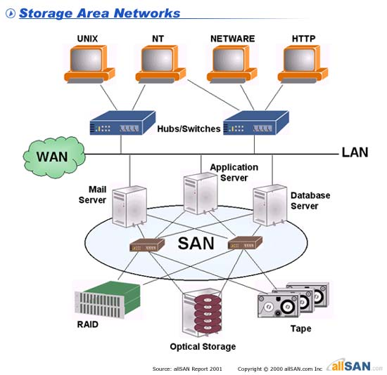
6. Storage Area Network
SAN may be referred to as a Sub network or special purpose network.
Its special purpose is to allow users on a larger network to connect various data storage devices with clusters of data servers.
SANs can be accessed in the same fashion as a drive attached to a server.
Notes:
I kept the graphic the same as the previous graphic representing the Wide Area Network in hopes of creating a degree familiarity. I also include some basic facts about it.

Slide 32
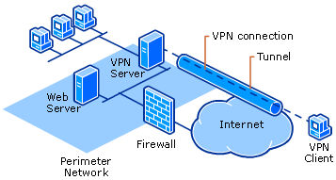
7. Virtual Private Network
VPN is a private network that can access public networks remotely. VPN uses encryption and security protocols to retain privacy while it accesses outside resources.
When employed on a network, VPN enables an end user to create a virtual tunnel to a remote location. Typically, telecommuters use VPN to log in to their company networks from home.
Authentication is provided to validate the identities of the two peers.
Confidentiality provides encryption of the data to keep it private from prying eyes.
Integrity is used to ensure that the data sent between the two devices or sites has not been tampered with.

Slide 33
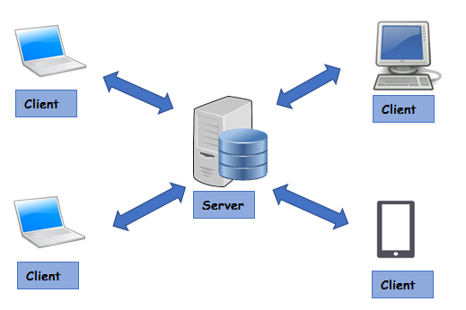
8. Client/Server Network
In a client/server arrangement, network services are located on a dedicated computer called a server.
The server responds to the requests of clients.
The server is a central computer that is continuously available to respond to requests from clients for file, print, application, and other services.
Most network operating systems adopt the form of a client/server relationship.
Typically, desktop computers function as clients, and one or more computers with additional processing power, memory, and specialized software function as servers.

Slide 34
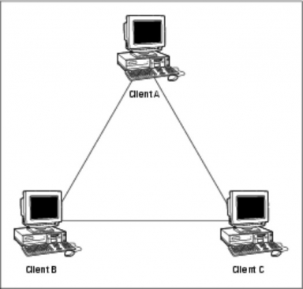
9. Peer to Peer Network
Usually very small networks
Each workstation has equivalent capabilities and responsibilities
Does not require a switch or a hub.
These types of networks do not perform well under heavy data loads.
Notes:
I kept the graphic the same as the previous graphic representing the Peer to Peer Area Network in hopes of creating a degree familiarity. I also include some basic facts about it.

Slide 35
Network Topologies
Network topology defines the structure of the network.
Physical topology:- It define the actual layout of the wire or media.
Bus
Ring
Star
Tree(Hierarchical)
Mesh
Logical topology:- It defines how the hosts access the media to send data.
Broadcast
Token passing
Hybrid Topology
Notes:
The topology section of my presentation may have been a little confusing for those who are not in the IT or networking field. I tried to explain the process and function of topologies using the three subsequent slides and the features of each topology.

Slide 36
1. Bus Topology
All devices are connected to a central cable, called bus or backbone.
There are terminators at each end of the bus that stops the signal and keeps it from traveling backwards.
T
T
Advantages:
There is no central controller.
Control resides in each station
The less interconnecting wire is required.
Ease of installation.
Backbone cable can be laid along the most efficient path, and then connected to the nodes by drop lines of various lengths
Disadvantages:
It is possible that more than one station may attempt transmission simultaneously (collision or contention).
Difficult reconfiguration and fault isolation.
A fault or break in the bus cable stops all transmission, even between devices on the same side of the problem.
The damaged area reflects signals in the direction of origin, creating noise in both directions
Notes:
I wanted to beak each of these down so it could be explained and understood better. While topology diagrams can be easily understood in the IT field they may be a little hard to grasp to average person.

Slide 37
2. Ring Topology
All devices are connected to one another in the shape of a closed loop.
Each device is connected directly to two other devices, one on either side of it.
Advantages:
Avoids the collisions that are possible in the bus topology.
Each pair of stations has a point-to-point connection.
A signal is passed along the ring in one direction, from device to another, until it reaches its destination.
Each device incorporates a repeater.
Relatively easy to install and reconfigure.
Fault isolation is simplified.
Disadvantages:
A break in the ring (such as station disabled) can disable the entire network.
Unidirectional traffic.
Notes:
I wanted to beak each of these down so it could be explained and understood better. While topology diagrams can be easily understood in the IT field they may be a little hard to grasp to average person.

Slide 38
3. Star Topology
All devices are connected to a central hub.
Nodes communicate across the network by passing data through the hub or switch.
Advantages:
1. Easy to install and reconfigure.
2. Robustness, if one link fails; only that link is affected. All other links remain active.
3. Easy fault identification and isolation. As long as the hub is working, it can be used to monitor link problems and bypass defective links.
Disadvantages:
1. The devices are not linked to each other.
2. If one device wants to send data to another, it sends it to the controller, which then relays the data to the other connected device.
Notes:
I wanted to beak each of these down so it could be explained and understood better. While topology diagrams can be easily understood in the IT field they may be a little hard to grasp to average person.

Slide 39
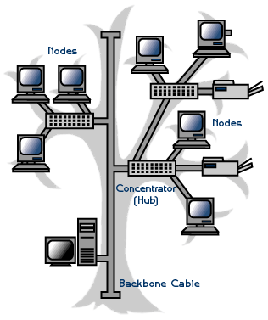
4. Tree/Hierarchical Topology
Advantages:
It allows more devices to be attached to a single central hub and can therefore increase the distance a signal can travel between devices.
It allows the network to isolate and prioritize communications from different computers.
Disadvantages:
The devices are not linked to each other.
If one device wants to send data to another, it sends it to the controller, which then relays the data to the other connected device.
The addition of secondary hubs brings two further advantages.
Notes:
I wanted to beak each of these down so it could be explained and understood better. While topology diagrams can be easily understood in the IT field they may be a little hard to grasp to average person.

Slide 40
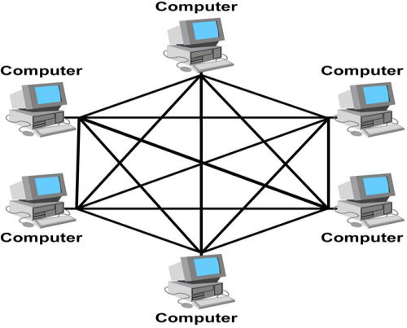
6. Mesh Topology
Each host has its connections to all other hosts.
Mesh topology is implemented to provide as much protection as possible from interruption of service.
A nuclear power plant might use a mesh topology in the networked control systems.
Although the Internet has multiple paths to any one location, it does not adopt the full mesh topology.
Advantages:
1. The use of dedicated links guarantees that each connection can carry its data load, thus eliminating the traffic problems that can occur when links must be shared by multiple devices.
2. It is robust, if one link becomes unusable, it does not incapacitate (affect) the entire system.
3. Privacy and Security (every message sent travels along a dedicated line; only the intended recipient sees it).
4. Point-to-point links make fault identification and fault isolation easy.
Disadvantages:
1. A large amount of cabling required.
2. A large amount of I/O ports required.
3. Installation and reconfiguration are difficult.
4. The sheer bulk of the wiring can be greater than the available space (in the walls, ceiling, or floors) can accommodate.
5. The hardware required to connect each link (I/O ports and cables) can be prohibitively expensive.
Notes:
I wanted to beak each of these down so it could be explained and understood better. While topology diagrams can be easily understood in the IT field they may be a little hard to grasp to average person.

Slide 41

Wireless Networks
Wireless network is a type of computer network that uses wireless data connections for connecting network nodes.
Example
Bluetooth
Wi-Fi

Slide 42
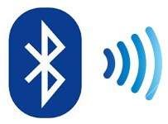
Bluetooth
Bluetooth is a short-range wireless technology standard used for exchanging data between fixed and mobile devices over short distances.
It is using UHF radio waves in the ISM bands, from 2.402 GHz to 2.48 GHz.
The IEEE standardized Bluetooth as IEEE 802.15.1, but no longer maintains the standard.

Slide 43
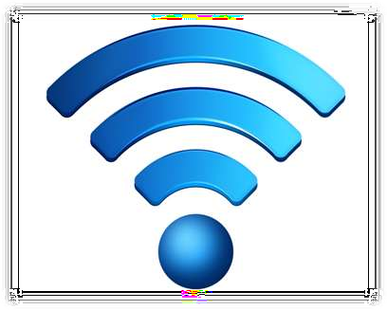
Wi-Fi
Wi-Fi Stands for Wireless Fidelity.
Wi-Fi, is a Local Area Wireless technology.
Wi-Fi networks use radio technologies to transmit and receive data at high speed.
It is based on the IEEE 802.11 family of standards.
Access point: The access point is a wireless LAN transceiver or “ base station” that can connect one or many wireless devices simultaneously to the internet

Slide 44

The Internet
The simplest definition of the Internet is that it's a network of computer networks
How Information Travel Through the Internet
A page on the Internet—whether it's full of words, images or both—doesn't come to you in one shipment. It's translated into digital information, chopped into 1500 byte pieces called PACKETS, and sent to you like a puzzle that needs to be reassembled. Each part of the packet has a specific function:
Sequence ID
ID’s where the information belongs in relation to the rest of the information
Header
Provides the complete destination address for the packet
End of Message
ID’s the end of the packet
Data Block
The portion of the overall information carried by the packet
Notes:
I used three slides to go over the Internet. I wanted to start of the first slide with a basic statement but, it would have an impact on the viewer.

Slide 45
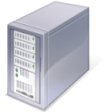

The Internet
How Information Travel Through the Internet
When you connect to a Web site through an ISP and start exchanging information, there isn't a fixed connection between your computer and the Web server computer hosting the Web site. Instead, information is exchanged using the best possible path at that particular time. Special computers called routers determine these paths, avoiding slow links and favoring fast ones.
Your Computer
Web Servers
ISP
Routers
Notes:
I would have like to use some animation for this but it would have been very difficult so I went ahead and use green and red colors to represent the flowing in data into the Internet and the flowing of data out of the Internet. I wanted to stress that data does not take the same path all the time when traveling to and from the Internet.

Slide 46
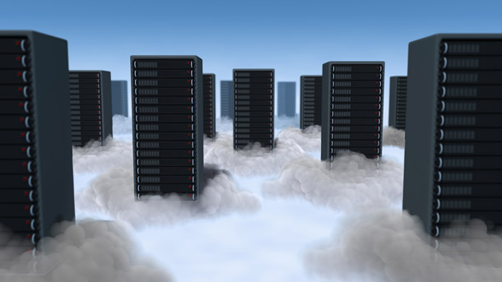
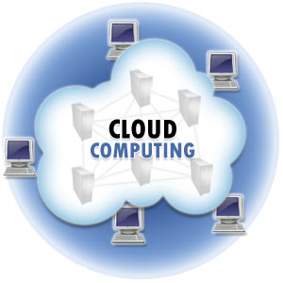
Cloud Computing
Cloud computing is Internet-based computing, whereby shared resources, software, and information are provided to computers and other devices on demand, like the electricity grid.
A Cloud is a type of parallel and distributed system consisting of a collection of interconnected and virtualized computers that are dynamically provisioned and presented as one or more unified computing resources based on service-level agreements established through negotiation between the service provider and consumers.
Notes:
IP addresses tend to go along with servers, especially web servers in that they store data for websites. Once again there is a good deal of information on this slide and I might could have separated Static and Temporary IP addresses into separate slides but I felt a side by side comparison was effective.

Slide 47

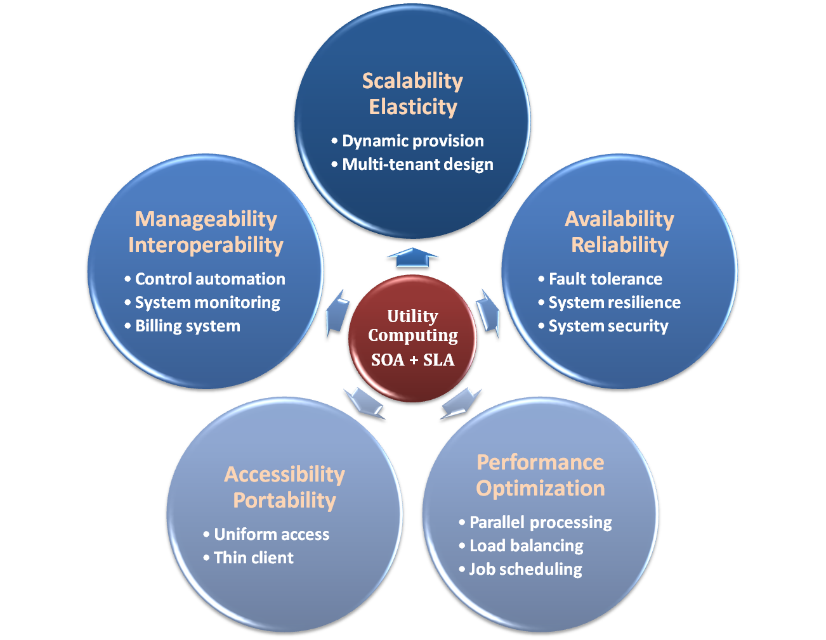
Properties & Characteristics
Notes:
IP addresses tend to go along with servers, especially web servers in that they store data for websites. Once again there is a good deal of information on this slide and I might could have separated Static and Temporary IP addresses into separate slides but I felt a side by side comparison was effective.

Slide 48
IaaS
Infrastructure as a Service – IaaS
The capability provided to the consumer is to provision processing, storage, networks, and other fundamental computing resources where the consumer is able to deploy and run arbitrary software, which can include operating systems and applications.
The consumer does not manage or control the underlying cloud infrastructure but has control over operating systems, storage, deployed applications, and possibly limited control of select networking components .
Examples :
Amazon EC2
Eucalyputs
OpenNebula
… etc
Notes:
IP addresses tend to go along with servers, especially web servers in that they store data for websites. Once again there is a good deal of information on this slide and I might could have separated Static and Temporary IP addresses into separate slides but I felt a side by side comparison was effective.

Slide 49
PaaS
Platform as a Service – PaaS
The capability provided to the consumer is to deploy onto the cloud infrastructure consumer-created or acquired applications created using programming languages and tools supported by the provider.
The consumer does not manage or control the underlying cloud infrastructure including network, servers, operating systems, or storage, but has control over the deployed applications and possibly application hosting environment configurations.
Examples :
Microsoft Windows Azure
Google App Engine
Hadoop(High Availability Distributed Object Oriented Platform)
… etc
Notes:
IP addresses tend to go along with servers, especially web servers in that they store data for websites. Once again there is a good deal of information on this slide and I might could have separated Static and Temporary IP addresses into separate slides but I felt a side by side comparison was effective.

Slide 50
SaaS
Software as a Service – SaaS
The capability provided to the consumer is to use the provider’s applications running on a cloud infrastructure. The applications are accessible from various client devices through a thin client interface such as a web browser (e.g., web-based email).
The consumer does not manage or control the underlying cloud infrastructure including network, servers, operating systems, storage, or even individual application capabilities, with the possible exception of limited user-specific application configuration settings.
Examples :
Google Apps (e.g., Gmail, Google Docs, Google sites, …etc)
Notes:
IP addresses tend to go along with servers, especially web servers in that they store data for websites. Once again there is a good deal of information on this slide and I might could have separated Static and Temporary IP addresses into separate slides but I felt a side by side comparison was effective.

Slide 51
Cloud-Deployment Model
There are four primary cloud deployment models :
Public Cloud
Private Cloud
Community Cloud
Hybrid Cloud
 | Public Cloud | Private Cloud
Infrastructure | Homogeneous | Heterogeneous
Policy Model | Common defined | Customized & Tailored
Resource Model | Shared & Multi-tenant | Dedicated
Cost Model | Operational expenditure | Capital expenditure
Economy Model | Large economy of scale | End-to-end control
Homogeneous

